Slide 1
A Game “Space Invaders”
Using PyGame ,Random ,Math
By Venkatesh Prasad

Slide 2
The Game Outline
Player ,enemy ,bullet coordinates (x,y)
For and while loops to run game continuously
Enemy coordinates are defined as “list”
Class to access collision test
User defined function like display score ,game over text
Conditional statement in loop
Input as key strokes from keyboard
Output displayed as score

Slide 3
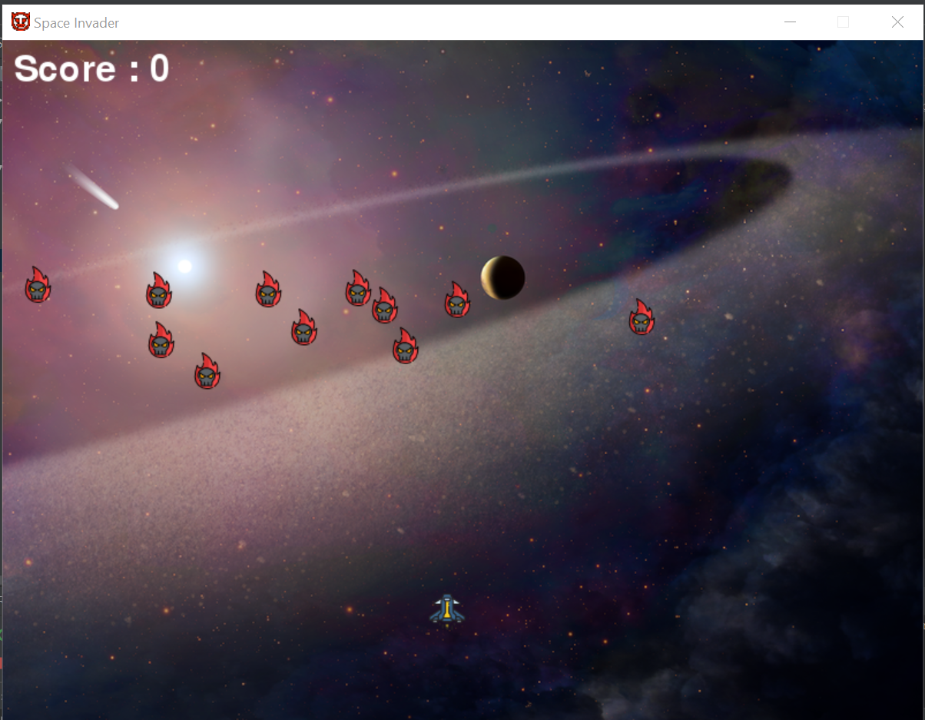
Screen

Slide 4
Layout of the Code
Create screen
Create Player
Create Enemy and the further implement in list
Create Bullet
Construct of game main loop
Define boundaries (player , enemies)
Define Bullet State
Collision check of enemy list with bullet
Implement score ,If enemy reaches near our space ship display game over

Slide 5
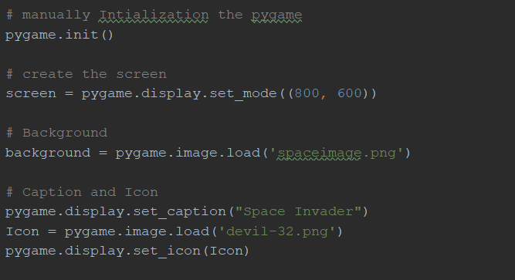
Project Screen using blit()
Initialize pygame
Display screen with width and height ,here (800,600)
Set a background image that matches the pixel size of screen
Add caption ,Icon

Slide 6
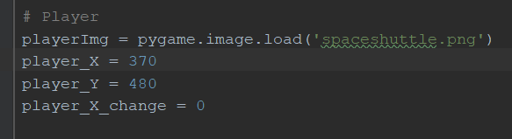
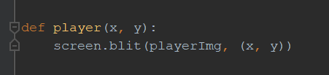
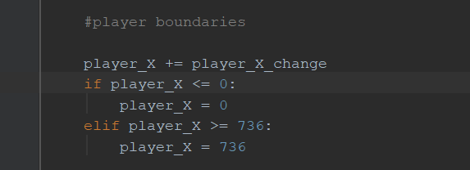
Player Details
Create a player X and Y co-ordinates
Define a player function to display player position
Assign the player within limits
As our player moves in only X axis we define single and initialize player Y co ordinate

Slide 7
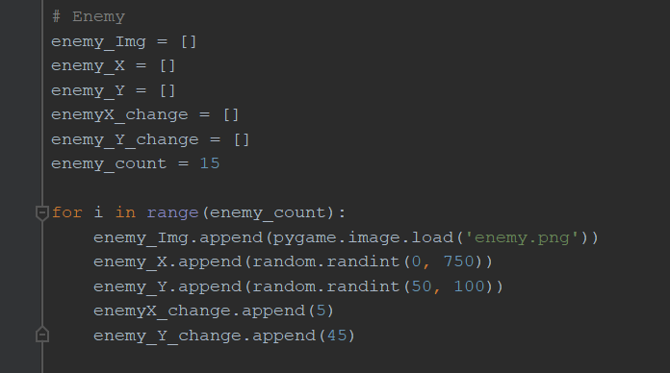
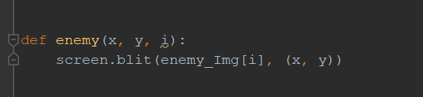
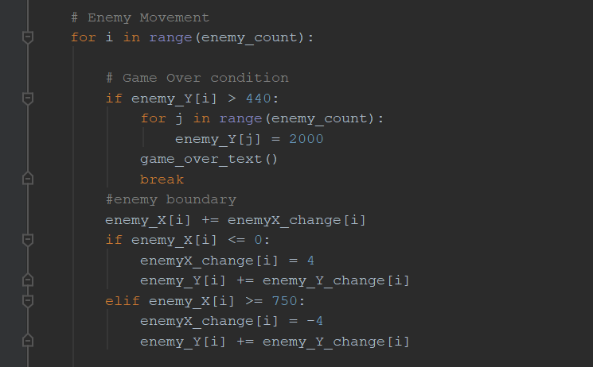
Enemy list
Create enemy X,Y ;x_change ,y_change ,number of enemies
Append all the enemies in a for loop which here is a random var.
Function enemy to blit screen
Define enemy movement in main game loop with exit condition and declaration of enemy movement

Slide 8
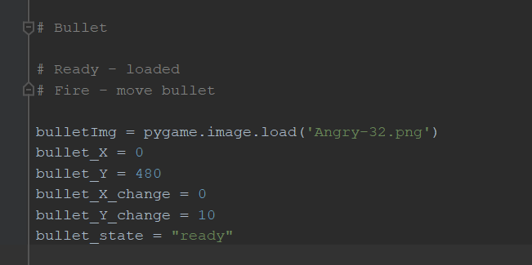
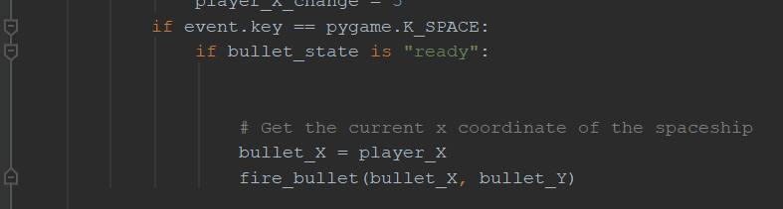
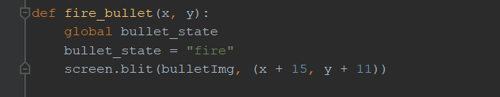
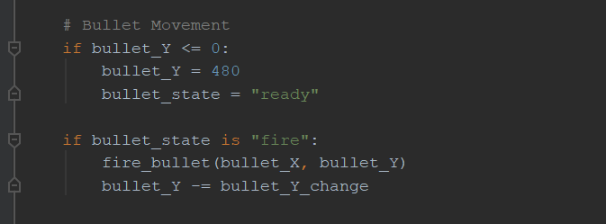
Fire Bullet
Create bullet x , y and the increment variable x change ,y change
Define bullet state = ready
When space is pressed bullet is function is called setting bullet state = fire
Globally declared state in function launches blit
Movement is tracked in the main loop

Slide 9
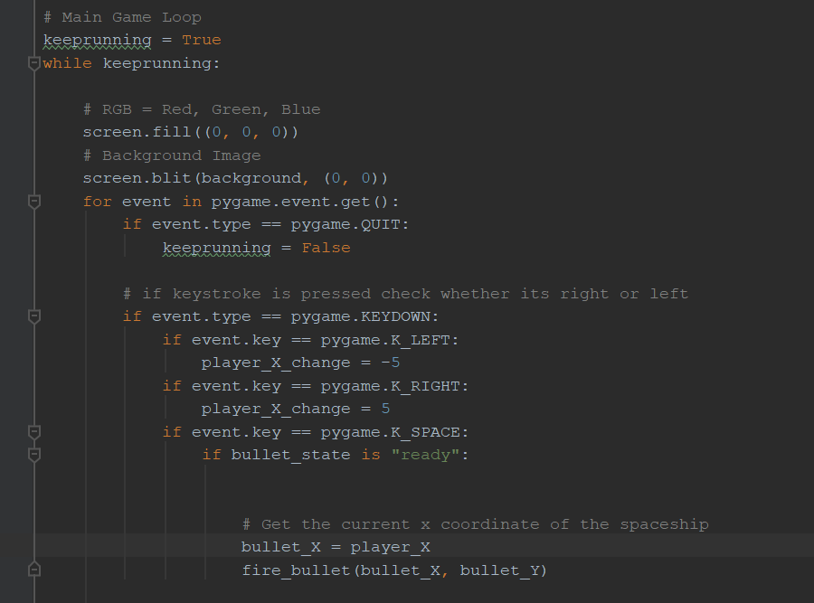
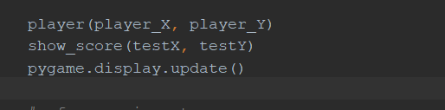
Main Game loop
Main Loop starts with while =True
Starting by filling black in screen followed by background image
A for loop to operate Keyboard operation
Inside event space we declare a condition when ready giving same co ordinates as player and then changing it independently in the called fire function
Call remaining functions

Slide 10
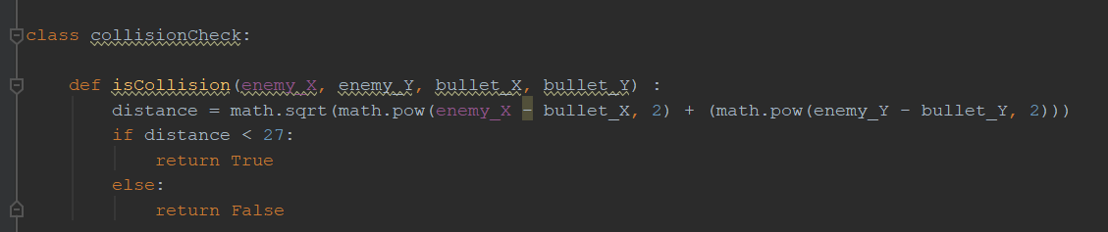
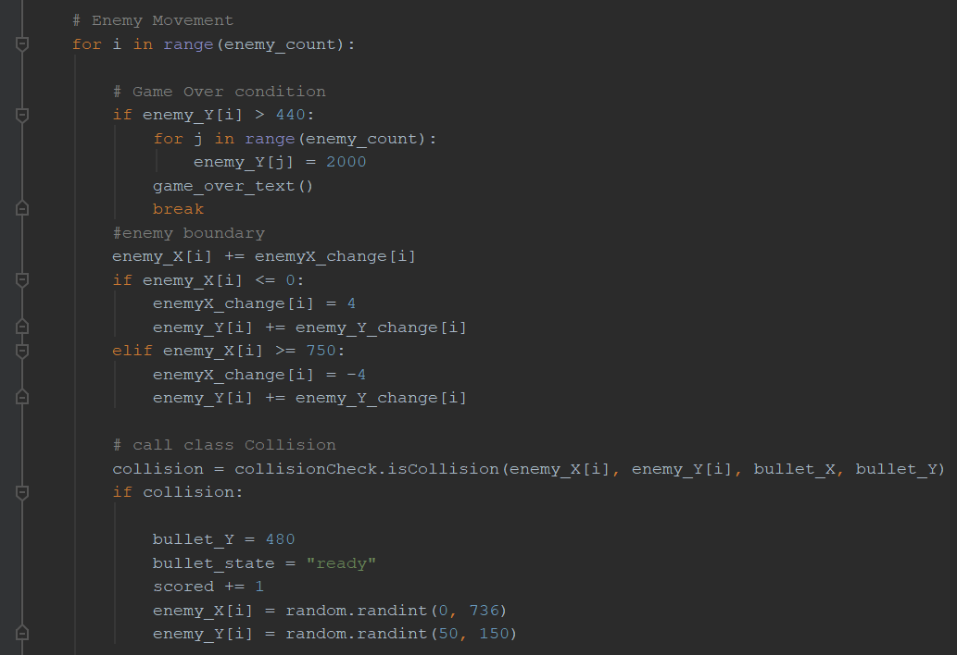
Collision Check
Define a class collision check with enemy(x,y),bullet (x,y)
If distance is small return true
Change bullet y , change state , increase score ,declare enemies per each enemy killed

Slide 11
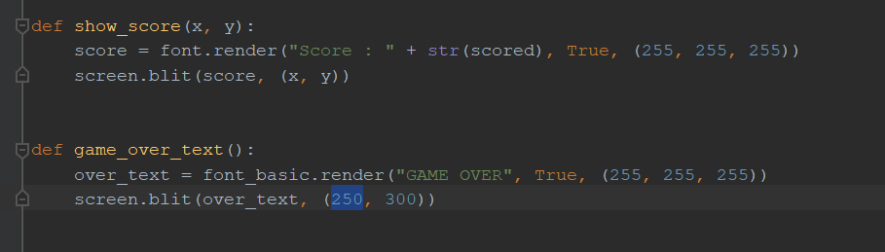
Printing score
A function show score at (x,y) co ordinates
Defining Game over function to display as the player losses the game in complete white color

Slide 12
End of presentation

